Slide 1
More About BC4J

Slide 2
Building custom data types using domain type
ADF allows you to customize the data types used for attributes in a business component by defining custom domain types. You can either extend the existing data types such as String, Integer, and Date, or build new domain types to represent a custom data structure such as Oracle Object type used in the database.
CREATE OR REPLACE TYPE ADDRESS_DETAIL AS OBJECT (CITY VARCHAR2(100), COUNTRY VARCHAR2(100));

Slide 3
Working with BLOB and CLOB data types
The BLOB (jbo.domain.BlobDomain) data type is used for storing large binary data, in a database table, such as images, audio, or other multimedia objects. The CLOB (oracle.jbo.domain.ClobDomain) data type is used to store large texts with a special sense to handle the character set used for the text.
ClobDomain b = new ClobDomain();
Writer out = b.getCharacterOutputStream();
InputStreamReader isr = new InputStreamReader(in);
char[] buffer = new char[8192];
int charsRead = 0;
while ((charsRead = isr.read(buffer, 0, 8192)) != -1) { out.write(buffer, 0, charsRead);
}
in.close();
out.close();

Slide 4
Working with BLOB and CLOB data types
BlobDomain b = new BlobDomain();
OutputStream out = b.getBinaryOutputStream();
byte[] buffer = new byte[8192]; int bytesRead = 0;
while ((bytesRead = in.read(buffer, 0, 8192)) != -1) {
out.write(buffer, 0, bytesRead);
}
in.close();
out.close();

Slide 5
BLOB and CLOB support for alternate databases
If your application uses a non-Oracle database, then you can use java.sql.Clob and java.sql.Blob attribute types in the entity objects and view objects to represent CLOB and BLOB database table columns. The java.sql.Clob and java.sql.Blob are interfaces; the actual implementation classes used by ADF runtime for these interfaces are:
oracle.jbo.domain.generic.GenericClob
oracle.jbo.domain.generic.GenericBlob

Slide 6
Building business components dynamically
The ADF Business Component framework allows you to programmatically define entity objects and view objects at runtime. This feature is useful when you need to deal with a highly dynamic business model where the same web UI may need to query or update different data sources depending upon the current user profile or other settings.
ADF entity objects and view objects expose APIs for building definitions at runtime.

Slide 7
Steps for building entity definition at runtime
EntityDefImpl::setFullName(String name) . Fully Qualified name
EntityDefImpl::setName(String name).
EntityDefImpl: :setAliasName(String s). Set the alias name which will be used by the framework while generating a query at runtime.
EntityDefImpl::setSource(String source). Set the name of the database source DB Obj
EntityDefImpl::setSourceType(String sourceType). such as table, view, and so on
addAttribute(String attrName, String columnName, Class javaType, boolean isPrimaryKey, boolean isDiscriminator, boolean isPersistent).
EntityDefIm pl::resolveDefObject(). When you call this API, the framework performs the validation and resolution of various part of the definition.
EntityDefImpl::w riteXMLContents(). Write the definition to an XML .
EntityDefImpl::saveXMLContents(). Save the definition to XML

Slide 8
Steps for building entity definition at runtime
//Step1: Build the entity definition object. should be marked as session scope.
EntityDefImpl entDef = new EntityDefImpl( oracle.jbo.server.EntityDefImpl.DEF_SCOPE_SESSION, "DynamicDeptEntityDef");
//Step 2: Set the full name for the entity definition
entDef.setFullName(entDef.getBasePackage() + ".dynamic." + entDef.getName());
//Step 3: Sets the name for entity definition
entDef.setName(entDef.getName()); //Step 4: Sets the alias which is used in query
entDef.setAliasName(entDef.getName()); //Step 5: Set the database table name entDef.setSource("DEPARTMENTS"); //Step 6: Set the database source type
entDef.setSourceType(EntityDefImpl.DBOBJ_TYPE_TABLE ); //Step 7:Add the attributes
entDef.addAttribute("DepartmentId", "DEPARTMENT_ID", Integer.class, true, false, true);
entDef.addAttribute("DepartmentName", "DEPARTMENT_NAME", String.class, false, false, true);
entDef.addAttribute("ManagerId", "MANAGER_ID", Integer.class, false, false, true);
//Step 8:Resolves entity definition and validates it before this definition object can be used.
entDef.resolveDefObject(); //Step 9: Write the definition to XML stream
entDef.writeXMLContents(); //Step 10:Save the XML file
entDef.saveXMLContents();

Slide 9
Steps for building a view definition with entity usage at runtime
ViewDefImpl::setFullName(String name)
addEntityUsage(String usageName, String entityDefName, boolean referenceOnly, boolean readOnly)
addAllEntityAttributes(String entityUsageName)
ViewDefImp ::resolveDefObject().
ViewDefImpl::writ eXMLContents().
ViewDefImpl::saveXMLContents().

Slide 10
Steps for building a view definition with entity usage at runtime
private ViewDefImpl buildDeptViewSessionDef(EntityDefImpl entityDef) {
//Step 1:Define the ViewDefImpl. All definitions created at runtime should be marked as session scope.
ViewDefImpl viewDef = new oracle.jbo.server.ViewDefImpl(oracle.jbo.server.ViewDefImpl.DEF_SCOPE_SESSION, "DynamicDeptViewDef"); //Step 2: Sets the full name for the view definition
viewDef.setFullName(viewDef.getBasePackage() + ".dynamic." viewDef.getName());
//Step 3: Sets the access mode and generic configurations
viewDef.setUseGlueCode(false);
viewDef.setIterMode(RowIterator.ITER_MODE_LAST_PAGE_FULL);
viewDef.setBindingStyle( SQLBuilder.BINDING_STYLE_ORACLE_NAME);
viewDef.setSelectClauseFlags(ViewDefImpl.CLAUSE_GENERATE_RT);
viewDef.setFromClauseFlags(ViewDefImpl.CLAUSE_GENERATE_RT); //Step 4:Add entity usage
viewDef.addEntityUsage("DynamicDeptUsage",entityDef.getFullName(), false, false); //Step 5:Add all attributes from entity
viewDef.addAllEntityAttributes("DynamicDeptUsage");//Step 6: It resolves attribute definitions with its entity bases.
viewDef.resolveDefObject(); //Step 7: Write to XML Stream
viewDef.writeXMLContents(); //Step 8: Save to XML file
viewDef.saveXMLContents();
return viewDef;
}

Slide 11
Steps for building a view definition with entity usage at runtime
Once the entity definition and view definition objects are in place, the last step in this exercise is to add the view object that we generated in the previous step to the desired application module. This is shown in the following code snippet.
private void addViewToPdefApplicationModule(ViewDefImpl viewDef) {
oracle.jbo.server.PDefApplicationModule pDefAM = oracle.jbo.server.PDefApplicationModule.findDefObject (getDefFullName());
if (pDefAM == null) {
pDefAM = new oracle.jbo.server.PDefApplicationModule();
pDefAM.setFullName(getDefFullName()); }
pDefAM.setEditable(true);
pDefAM.createViewObject(DYNAMIC_DETP_VO_INSTANCE, viewDef.getFullName());
pDefAM.applyPersonalization(this);
pDefAM.writeXMLContents(); pDefAM.saveXMLContents(); }

Slide 12
Personalized business components
Oracle ADF Business Components use personalization definition objects to customize the business component definitions at runtime. ADF uses oracle.jbo. server.PDefEntityObject, oracle.jbo.server.PDefViewObject, and oracle. jbo.server.PDefApplicationModule to store the runtime customization for an entity object, view objects, and application modules respectively.
The runtime changes are stored in the Meta Data Service (MDS) store. All the structural changes are stored at site level, reflecting changes across all user sessions.

Slide 13
Personalized business components
private boolean addLocAttributeToDeptView() {
ViewDefImpl viewDef = ViewDefImpl.findDefObject("sessiondef.dynamic.DynamicDeptViewDef");
PDefViewObject pDefVO = (PDefViewObject)viewDef. getPersDef();
//Step 2- No personalization exist, then create a new PDefViewObject
if (pDefVO == null) { pDefVO = new PDefViewObject();
pDefVO.setFullName(viewDef.getFullName()); }
//Step 3- check if "LocationId" exist in the defnition
if (pDefVO.getAttributeIndexOf("LocationId") != -1) { return false; }
//Step 4- If no definition exist for "LocationId", then
pDefVO.setEditable(true);
pDefVO.addEntityAttribute("LocationId", "DynamicDeptUsage", "LocationId", true);
pDefVO.applyPersonalization(findViewObject( DYNAMIC_DETP_VO_INSTANCE));
pDefVO.writeXMLContents();
pDefVO.saveXMLContents(); return true; }

Slide 14
Programmatically building a master-child view object
//In Application Module
ViewLink empsInDepartment = createViewLinkBetweenViewObjects( "DynamicDeptEmpViewLink",
"EmployeesInDepartment",
deptView,new AttributeDef[]{deptView.findAttributeDef("DepartmentId")}, empView, new AttributeDef[]{empView.findAttributeDef("DepartmentId")}
, "DEPARTMENT_ID = :Bind_DepartmentId");

Slide 15
Integrating Service-Enabled Application Modules
Service-enabled application modules are ADF application modules that you advertise through a service interface to service consumers. There are three scenarios for service consumers to consume a published service-enabled application module: web service access, Service Component Architecture (SCA : Remoteable services or Local services) composite access, and access by another ADF application module.
When you service-enable your application module, JDeveloper generates the necessary artifacts comprising
The Java interface defining the service,
an EJB 3.0 session bean that implements this Java interface,
a WSDL file that describes the service’s operations, and
an XML Schema Document (XSD) that defines the service’s data structures.

Slide 16
Publishing Service-Enabled Application Modules
JDeveloper allows you to expose application modules as web services which use SDO components based on view instance that your application module defines to standardize the way that data structures are passed between Java and XML.
The service-enabled application module exposes the view objects, custom methods, built-in data manipulation operations, and specialized find methods based on named view criteria to be used by the client. Once you have enabled the application module service interface, you will need to create an ADF Business Components Service Interface deployment profile and deploy it to the target application server

Slide 17
How to Enable the Application Module Service Interface
The primary purpose of the standard service operations is to expose data manipulation operations on the view objects.
Create | create<VOName>
Update | update<VOName>
Delete | delete<VOName>
Merge | merge<VOName>
GetByKey | get<VOName>
Find (by view object query statement) | find<VOName>
Find (by view criteria) | find<VOName><VCName>
Process | process<VOName>
ProcessChangeSummary | processCS<VOName>

Slide 18
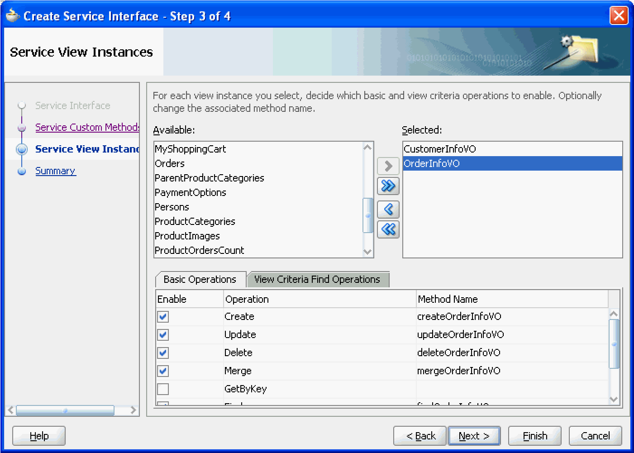
Publishing Service-Enabled Application Modules

Slide 19
Method Signatures on the ADF Web Service Interface
You can define two different kinds of interfaces for an application module: the client interface and the service interface. The client interface is used by the ADF Model layer for UI clients.
Java primitive types and their object wrapper types (for example, int, Integer, and Long , java.util.List)
java.lang.String | oracle.jbo.domain.Char | java.util.Date
java.math.BigDecimal | oracle.jbo.domain.ClobDomain | oracle.jbo.AttributeList
java.math.BigInteger | oracle.jbo.domain.DBSequence | oracle.jbo.domain.BlobDomain
java.sql.Date | oracle.jbo.domain.Date | oracle.jbo.domain.Char
java.sql.Time | oracle.jbo.domain.NClobDomain | oracle.jbo.server.ViewRowImpl
java.sql.Timestamp | oracle.jbo.domain.Number | oracle.jbo.domain.TimestampTZ
oracle.jbo.domain.Timestamp | oracle.jbo.domain.TimestampLTZ

Slide 20
Support Nested Processing in Service-Enabled Master-Detail View Objects
The view link uses the default composition association, then post operations on the detail view object are supported by default.
The view link is based on an association, and the association has the destination
accessor generated, and the association has a custom property SERVICE_PROCESS_CHILDREN=true defined.
The view link is not based on an association but has a custom property SERVICE_PROCESS_CHILDREN=true defined.

Slide 21
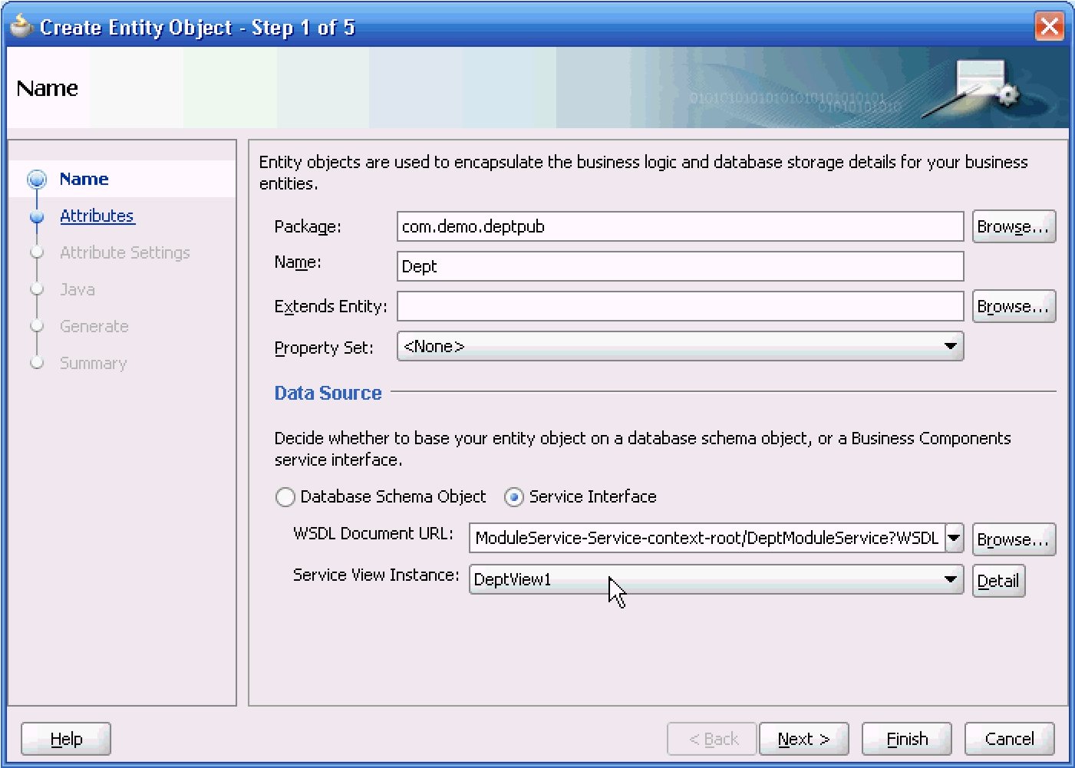
Accessing Remote Data Over the Service-Enabled Application Module
View Object Can Be Created from Service-Backed Entity Object

